Slide 1

Jaypee university of informaton technology
Presented by Guided by:-
1)Ayush singh(211179) Abhilasha sharma

Slide 2

Employee Management System

Slide 3
Content

Slide 4
Introduction
Every organisation keeps a record of their staff.
Staff records play a crucial role in staff
management. Every organisation requires these
records to calculate pay, manage workforce and see
performance of employees Management of all
these records is a challenging task and time
consuming process for the HR team , which can
be reduced by using EMS that is the Employee
Management System

Slide 5
Cont.
All organisations both private and public
have necessities of employee management
systems. But from years they have been using an
old classical method that is pen and paper to
maintain record, however in the past few years
there has been a large increase toward using
automatic systems that can manage salary
calculation by their own

Slide 6
Problem statement
Employee management system is a system
developed with an aim to solve the problem faced
by organisations while calculating salary of each
employee. This system
makes sure that all the important calculations
should be done to calculate salary properly. EMS
promotes automatic use and ensures employees
that their salary would be calculated properly
without any cheating.

Slide 7
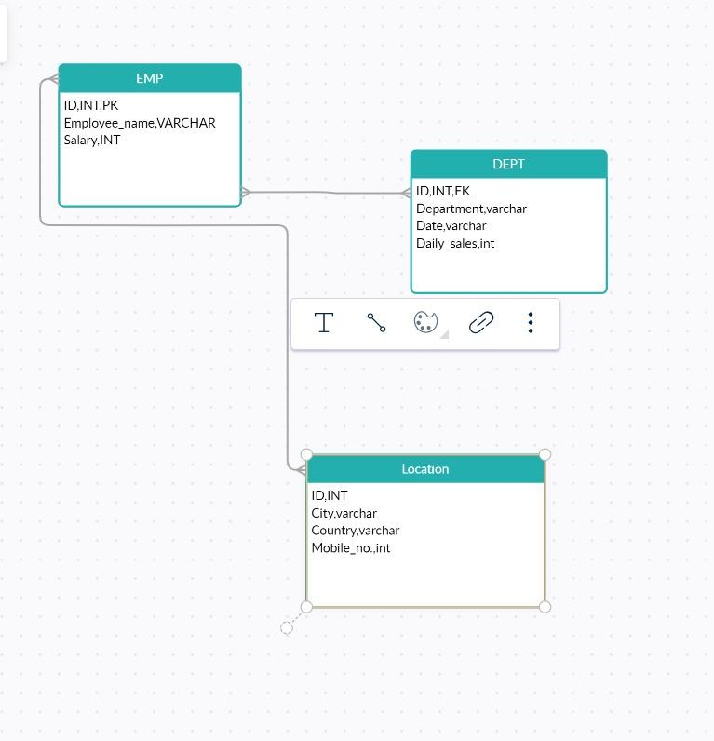
Schema

Slide 8
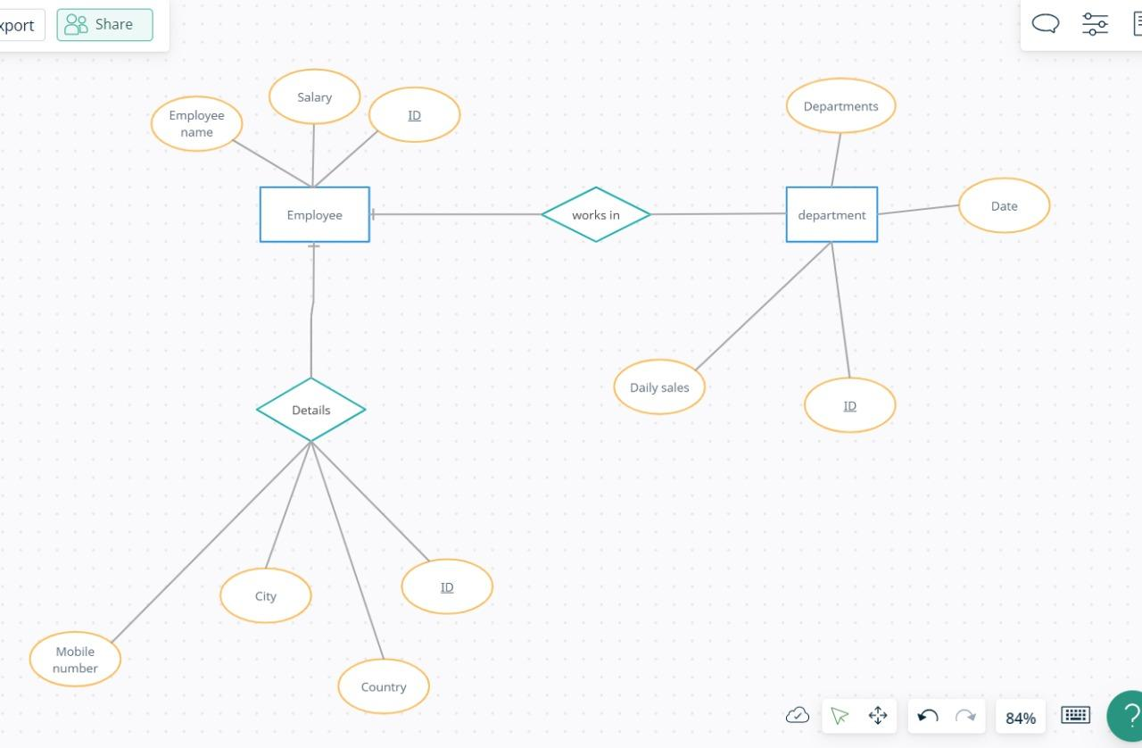
ER diagram

Slide 9
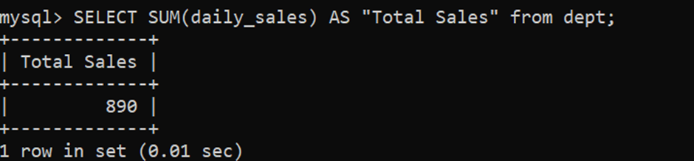
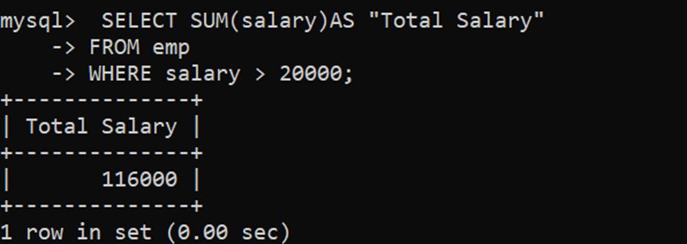
Table and query

Slide 10
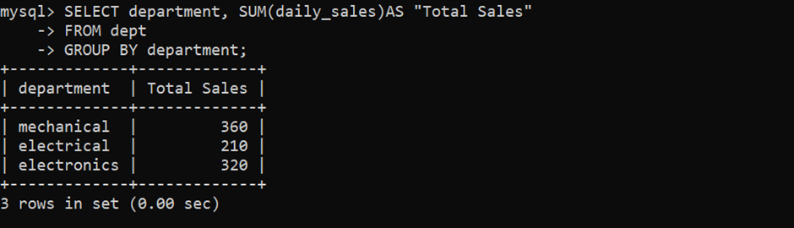
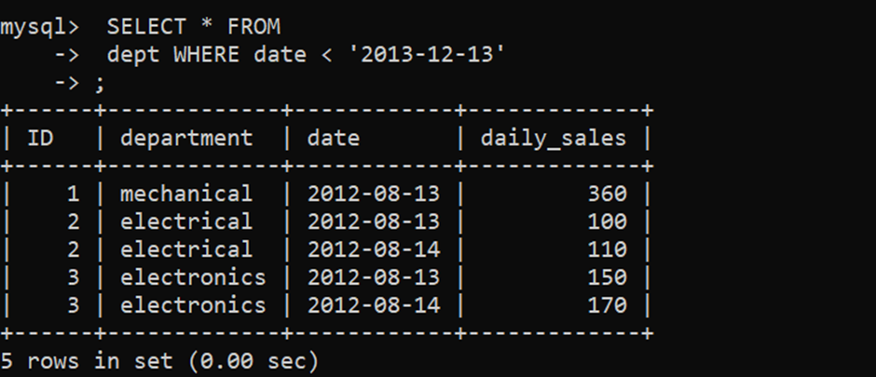

Slide 11
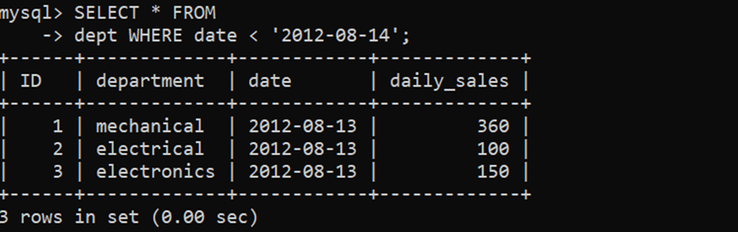

Slide 12
Thank you
.

